Slide 1
Design and Analysis of Algorithms
Algorithms-II : CS345A
Lecture 10
A generic way to design Greedy Algorithms

Slide 2
Finding the labeled binary tree for
Recap of last lecture
the optimal prefix codes

Slide 3



Optimal Prefix Coding
Algorithmic Problem: Given a set $A$of $n$alphabets and their frequencies,
compute coding $γ$ such that
$γ$ is prefix coding
$ABL\left(γ\right)$ is minimum.
Non-decreasing order of frequency
$${f(a}_{i})≤{f(a}_{i+1})$$
$a_{1}$ , $a_{2}$ , … , $a_{n}$

Slide 4


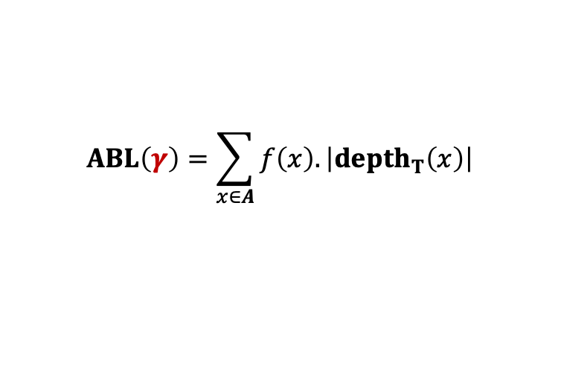

The binary tree of the optimal prefix code
0
1
0
1
0
1
. . .
1
0
1
Deepest level
$$a_{1}$$
$$a_{2}$$
Theorem: There exists an optimal prefix coding
in which $a_{1}$and $a_{2}$ appear as siblings
$$ABL\left(γ\right)=\sum_{x∈A}{f\left(x\right).\left|depth_{T}\left(x\right)\right|}$$

Slide 5





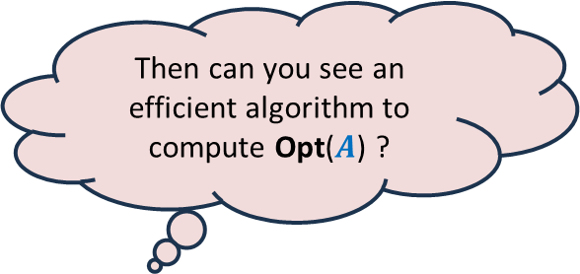




A generic way to design and analyse a greedy algorithm
Suppose the Greedy step is such that
we can efficiently obtain Opt($A$) from Opt($A′$).
P: a given optimization problem
So, all you need is to just design the Greedy step appropriately.
Opt($A$)
$$A$$
instance of size $n$of problem P
Then can you see an efficient algorithm to compute Opt($A$) ?
Greedy
step
?
Opt($A′$)
$$A′$$
instance of size $<n$of problem P
Ponder over this inference for some time.
Isn’t it amazing ?
Greedy
step
Yes, a simple recursive algorithm.☺
$$A′′$$
…
Opt($A′$)
Base case
Notes:
Let us illustrate its usefulness with the help of an example.

Slide 6
Example Minimum spanning tree

Slide 7

instance $A$
170
54
33
63
35
50
70
31
41
81
64
78
53
42
52
80
49
54
42
60
44
43
50
30
49
57
29
102

Slide 8

instance $A$
Theorem 1 : There is an MST($A$) with edge (u,v)
170
54
33
63
35
50
70
31
41
81
64
78
53
42
52
80
49
54
42
60
44
43
50
30
49
57
u
29
102
v

Slide 9


instance $A′$
Theorem 1 : There is an MST($A$) with edge (u,v)
170
54
33
63
35
50
70
31
41
81
64
78
53
42
52
80
49
54
42
44
60
43
50
30
49
57
w
102

Slide 10
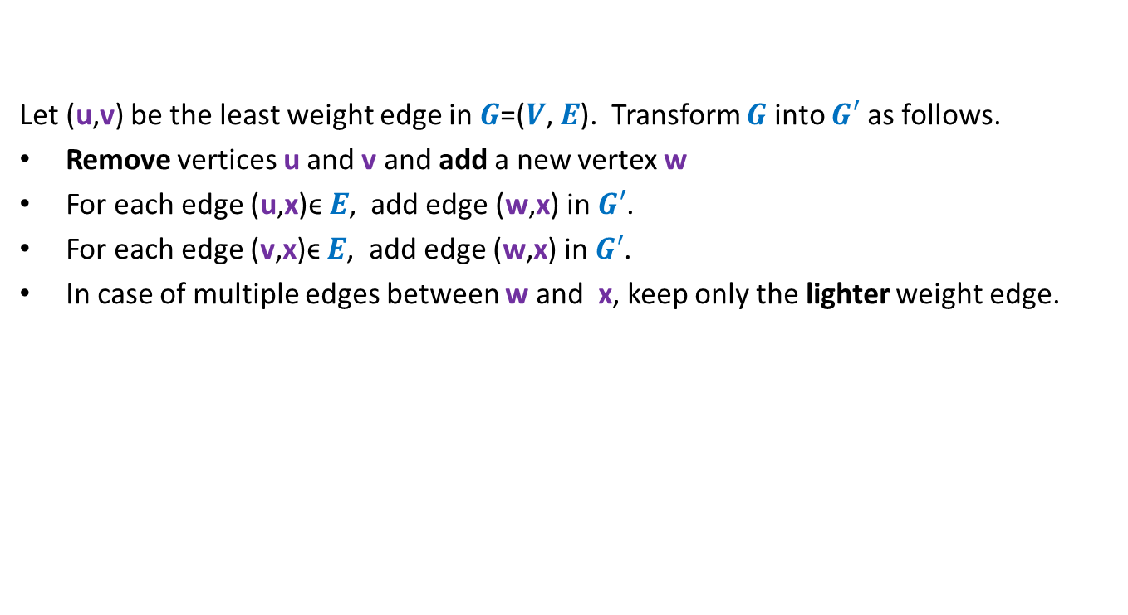

How to compute instance $A′$ ?
Let (u,v) be the least weight edge in $G$=($V$, $E$). Transform $G$ into $G′$ as follows.
Remove vertices u and v and add a new vertex w
For each edge (u,x)ϵ $E$, add edge (w,x) in $G′$.
For each edge (v,x)ϵ $E$, add edge (w,x) in $G′$.
In case of multiple edges between w and x, keep only the lighter weight edge.

Slide 11




Homework
Weight of MST($A$) $=$ Weight of MST($A′$) $+$w(u,v)
In the rest of the lecture, we shall discuss a technique which will also help you do this homework.
MST($A$)
$$A$$
Greedy
step
How ?
Using Theorem 1
MST($A′$)
$$A′$$

Slide 12
Finding the labeled binary tree for
the optimal prefix codes

Slide 13

The binary tree of the optimal prefix code
From this picture, can you design the greedy step that you will perform to compute the smaller instance ?
0
1
0
1
0
1
. . .
1
0
1
Deepest level
$$a_{1}$$
$$a_{2}$$
Theorem 2: There exists an optimal prefix coding
in which $a_{1}$and $a_{2}$ appear as siblings

Slide 14


The binary tree of the optimal prefix code
0
1
0
1
0
1
. . .
1
Deepest level
$a$’
$f\left(a\text{’}\right)=$ $f\left(a_{1}\right)+f\left(a_{2}\right)$

Slide 15
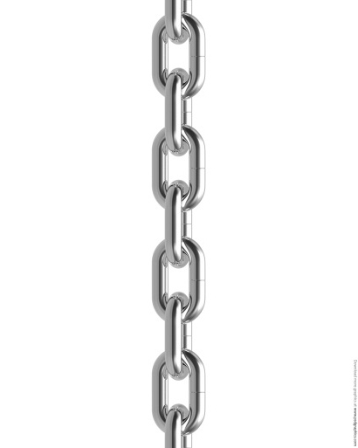



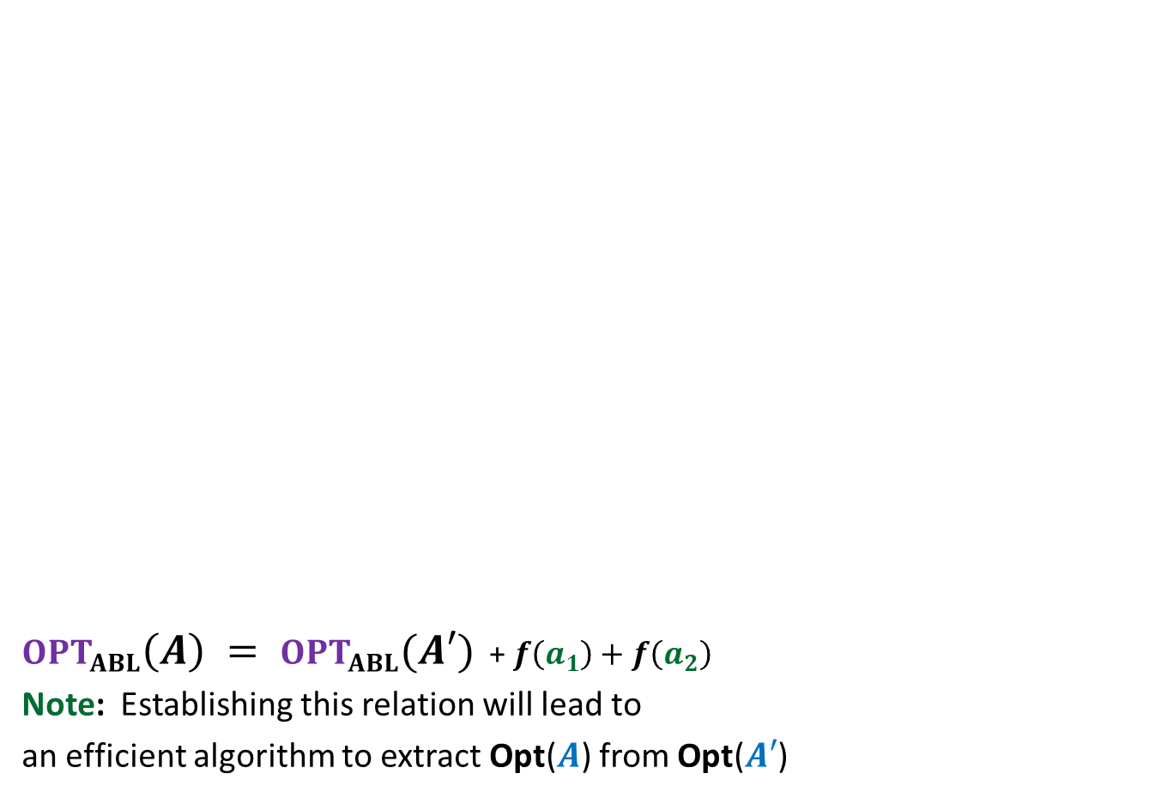





$OPT_{ABL}\left(A\right) = OPT_{ABL}(A′)$ + $f\left(a_{1}\right)+f\left(a_{2}\right)$
Note: Establishing this relation will lead to
an efficient algorithm to extract Opt($A$) from Opt($A′$)
Opt($A$)
$$A$$
$a_{1}$, $a_{2}$, $a_{3}$ , … … $a_{n}$
Greedy
step
Relation ?
Opt($A′$)
$$A′$$
$a_{3}$ , … … $a_{n}$
$$a′$$
$f\left(a\text{’}\right)=$ $f\left(a_{1}\right)+f\left(a_{2}\right)$
?

Slide 16
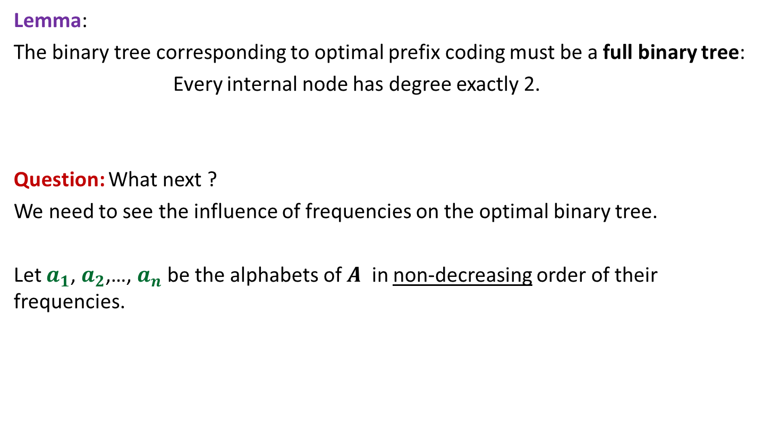
Proof for $OPT_{ABL}\left(A\right)=OPT_{ABL}(A′)$ + $f\left(a_{1}\right)+f\left(a_{2}\right)$
Spend some time thinking about the proof
before moving ahead.
☺

Slide 17

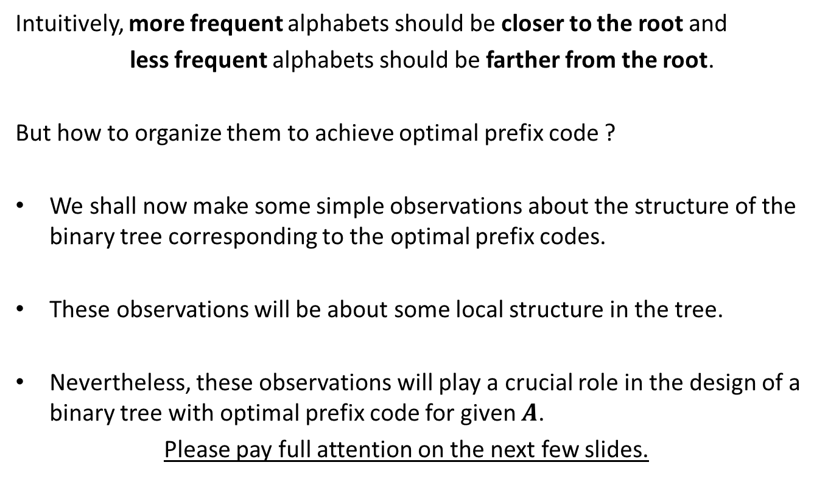
How to prove $OPT_{ABL}\left(A\right)=OPT_{ABL}(A′)$ + $f\left(a_{1}\right)+f\left(a_{2}\right)$ ?
Question: Can we derive a prefix coding for $A$from $OPT(A′)$ ?
Question: Can we derive a prefix coding for $A′$from $OPT(A)$ ?

Slide 18




A prefix coding for $A$from $OPT\left(A^{′}\right)$
$T′$: the binary tree corresponding to $OPT_{ABL}(A′)$
0
1
0
1
0
1
$$T′$$
. . .
1
$a$’

Slide 19

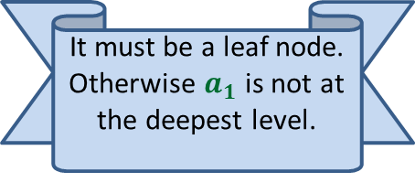

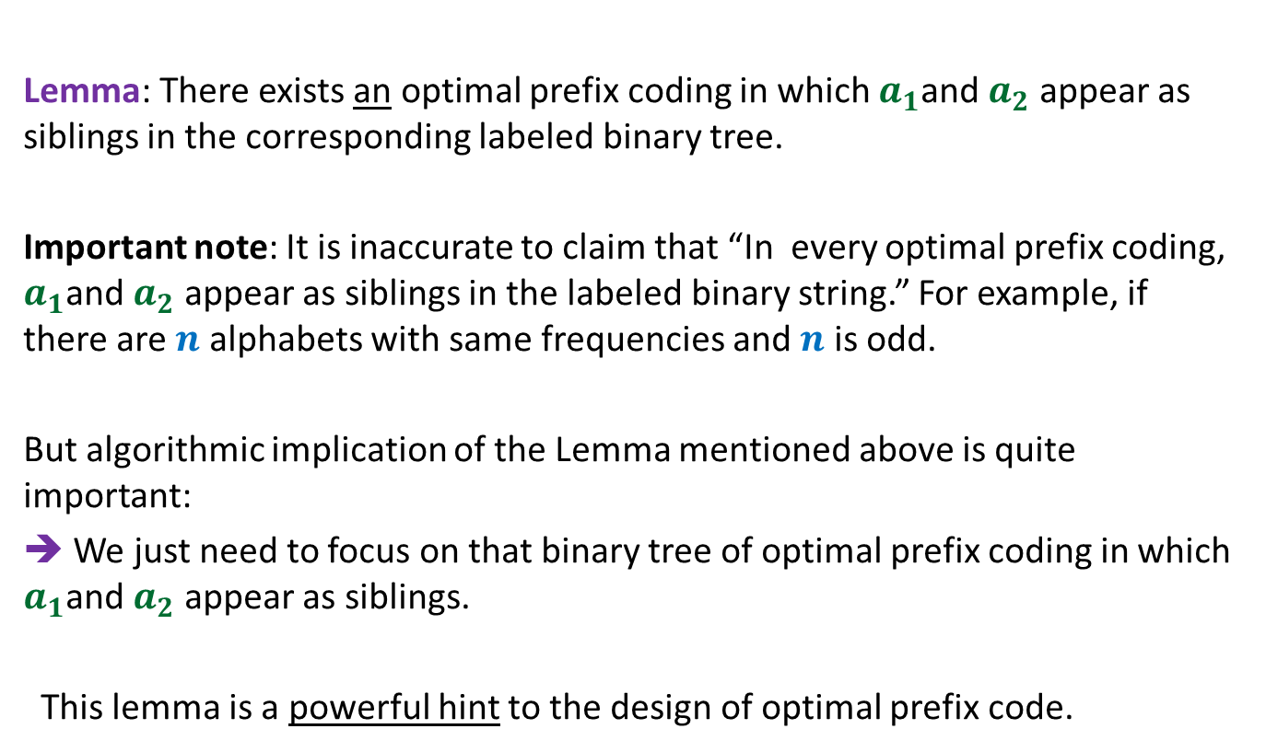


A prefix coding for $A$from $OPT\left(A^{′}\right)$
$T′$: the binary tree corresponding to $OPT_{ABL}(A′)$
This gives a prefix coding for $A$ with $ABL$ = ??
➔ $OPT_{ABL}\left(A\right)≤OPT_{ABL}(A′)$ + $f\left(a_{1}\right)+f\left(a_{2}\right)$
0
1
0
1
0
1
$$T′$$
. . .
1
0
1
$a$’
$$a_{1}$$
$$a_{2}$$
$OPT_{ABL}(A′)$ + $f\left(a_{1}\right)+f\left(a_{2}\right)$

Slide 20





A prefix coding for $A′$from $OPT(A)$
$T$: the binary tree corresponding to $OPT_{ABL}(A)$
0
1
Using Theorem 2
0
1
0
1
$$T$$
. . .
1
0
1
Deepest level
$$a_{1}$$
$$a_{2}$$

Slide 21

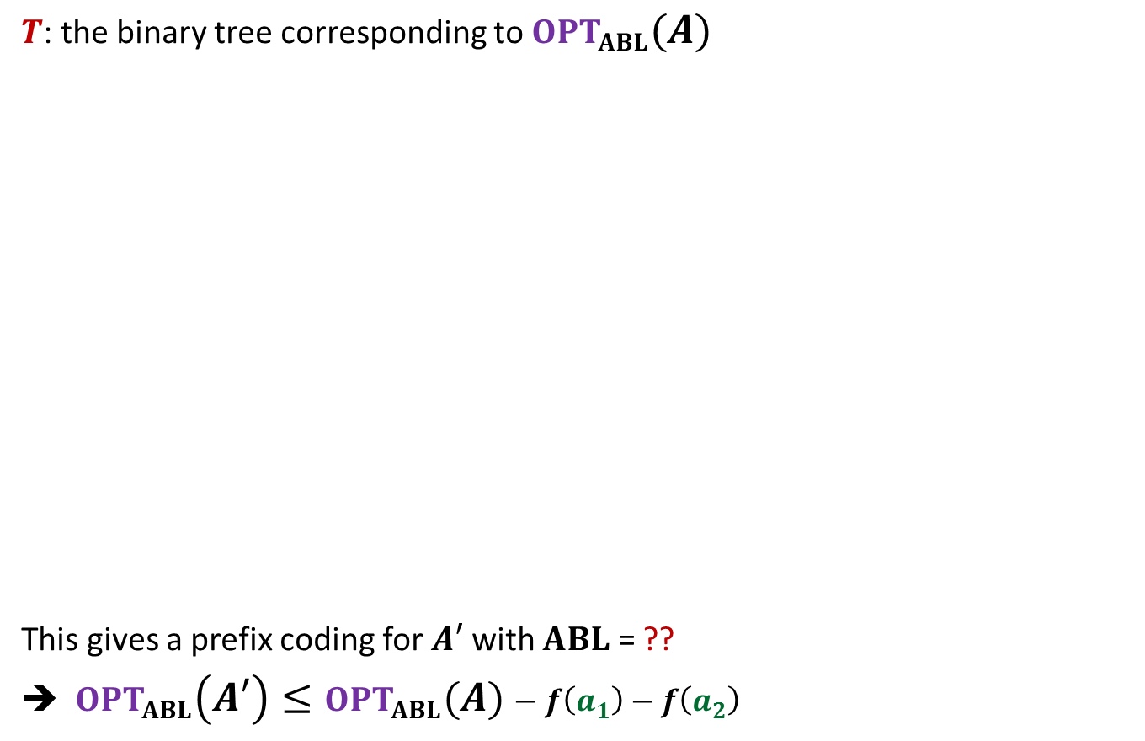

A prefix coding for $A′$from $OPT(A)$
$T$: the binary tree corresponding to $OPT_{ABL}(A)$
This gives a prefix coding for $A′$ with $ABL$ = ??
➔ $OPT_{ABL}\left(A′\right)≤OPT_{ABL}(A)−f\left(a_{1}\right)−f\left(a_{2}\right)$
0
1
Using Theorem 2
0
1
0
1
$$T$$
. . .
1
0
1
$a$’
Deepest level
$$a_{1}$$
$$a_{2}$$
$$OPT_{ABL}\left(A\right)−f\left(a_{1}\right)−f\left(a_{2}\right)$$

Slide 22
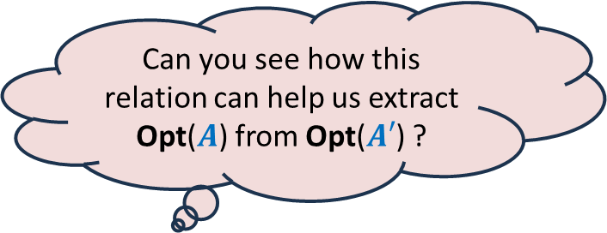
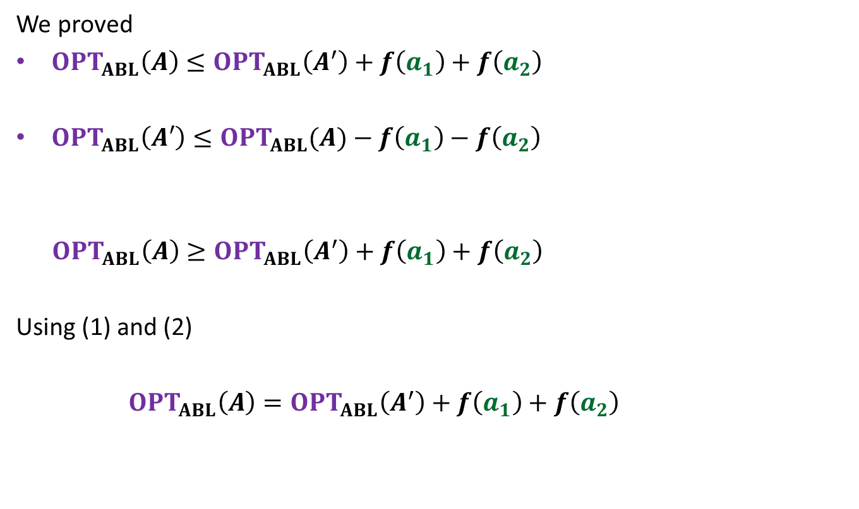
We proved
$OPT_{ABL}\left(A\right)≤OPT_{ABL}\left(A^{′}\right)+f\left(a_{1}\right)+f\left(a_{2}\right)$
$OPT_{ABL}\left(A′\right)≤OPT_{ABL}(A)−f\left(a_{1}\right)−f\left(a_{2}\right)$
$OPT_{ABL}\left(A\right)≥OPT_{ABL}\left(A^{′}\right)+f\left(a_{1}\right)+f\left(a_{2}\right)$
Using (1) and (2)
$OPT_{ABL}\left(A\right)=OPT_{ABL}\left(A^{′}\right)+f\left(a_{1}\right)+f\left(a_{2}\right)$
(1)
Can you see how this relation can help us extract Opt($A$) from Opt($A′$) ?
(2)

Slide 23

We have established
$$OPT_{ABL}\left(A\right)=OPT_{ABL}\left(A^{′}\right)+f\left(a_{1}\right)+f\left(a_{2}\right)$$
A prefix coding for $A$from $OPT\left(A^{′}\right)$
So
$T′$: the binary tree corresponding to $OPT_{ABL}(A′)$
This gives a prefix coding for $A$ with $ABL$ = ??
➔ $OPT_{ABL}\left(A\right)≤OPT_{ABL}(A′)$ + $f\left(a_{1}\right)+f\left(a_{2}\right)$
0
1
0
1
0
1
$$T′$$
. . .
1
0
1
$a$’
$$a_{1}$$
$$a_{2}$$
$OPT_{ABL}(A′)$ + $f\left(a_{1}\right)+f\left(a_{2}\right)$
$$=$$

Slide 24

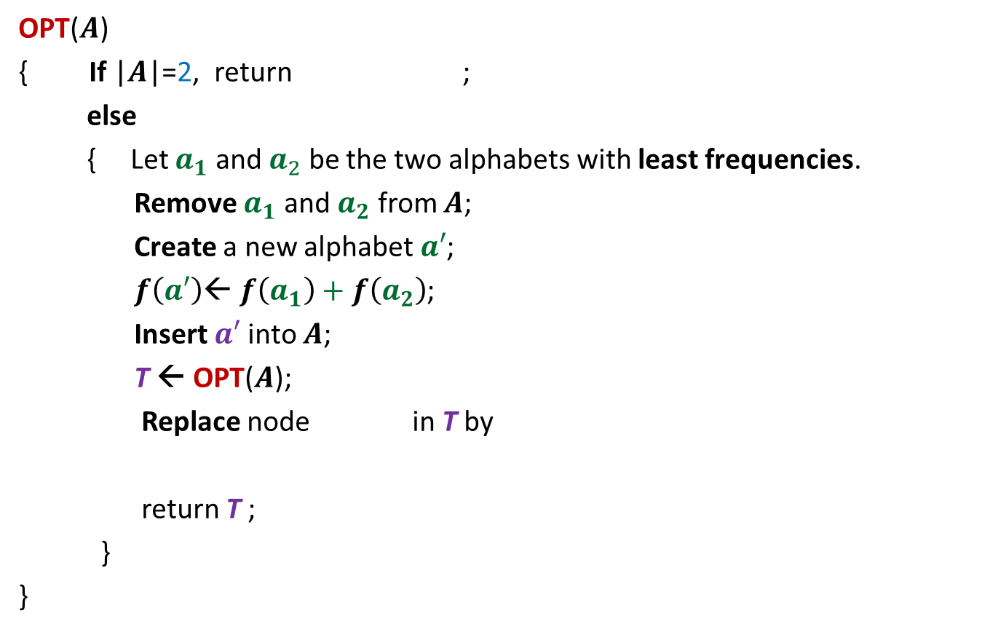







The algorithm based on $OPT_{ABL}\left(A\right)=OPT_{ABL}(A′)$ + $f\left(a_{1}\right)+f\left(a_{2}\right)$
OPT($A$)
{ If |$A$|=2, return ;
else
{ Let $a_{1}$ and $a_{2}$ be the two alphabets with least frequencies.
Remove $a_{1}$ and $a_{2}$ from $A$;
Create a new alphabet $a′$;
$f\left(a′\right)$← $f\left(a_{1}\right)+f\left(a_{2}\right)$;
Insert $a′$into $A$;
T ← OPT($A$);
Replace node in T by
return T ;
}
}
0
1
$$a_{1}$$
$$a_{2}$$
$O(n^{2})$ time complexity
Homework:
Achieve $O(n log n)$ time complexity
0
1
$a$’
$$a_{1}$$
$$a_{2}$$

Slide 25






A generic way to design and analyse a greedy algorithm
P: a given optimization problem
1. Try to establish a relation between OPT($A$) and OPT($A′$);
2. Try to prove the relation formally by
deriving a solution of $A$ from OPT($A′$)
deriving a solution of $A′$ from OPT($A$)
If you succeed,
you have an algorithm
Opt($A$)
$$A$$
instance of size $n$of problem P
Greedy
step
based on a suitable Theorem about Opt($A$)
Opt($A′$)
$$A′$$
instance of size $<n$of problem P
from construction
use Theorem

Slide 26
More Homework

Slide 27

The 2 problems we discussed
Synchronizing the delays in a circuit
Scheduling jobs to minimize maximum lateness
Electric signal
6
5
3
2
4
2
$$0$$
time
2
1
6
2
1
2
3
2
Design and analyse a greed algorithm based on the generic technique.

Slide 28
Shortest pathS in a graph

Slide 29


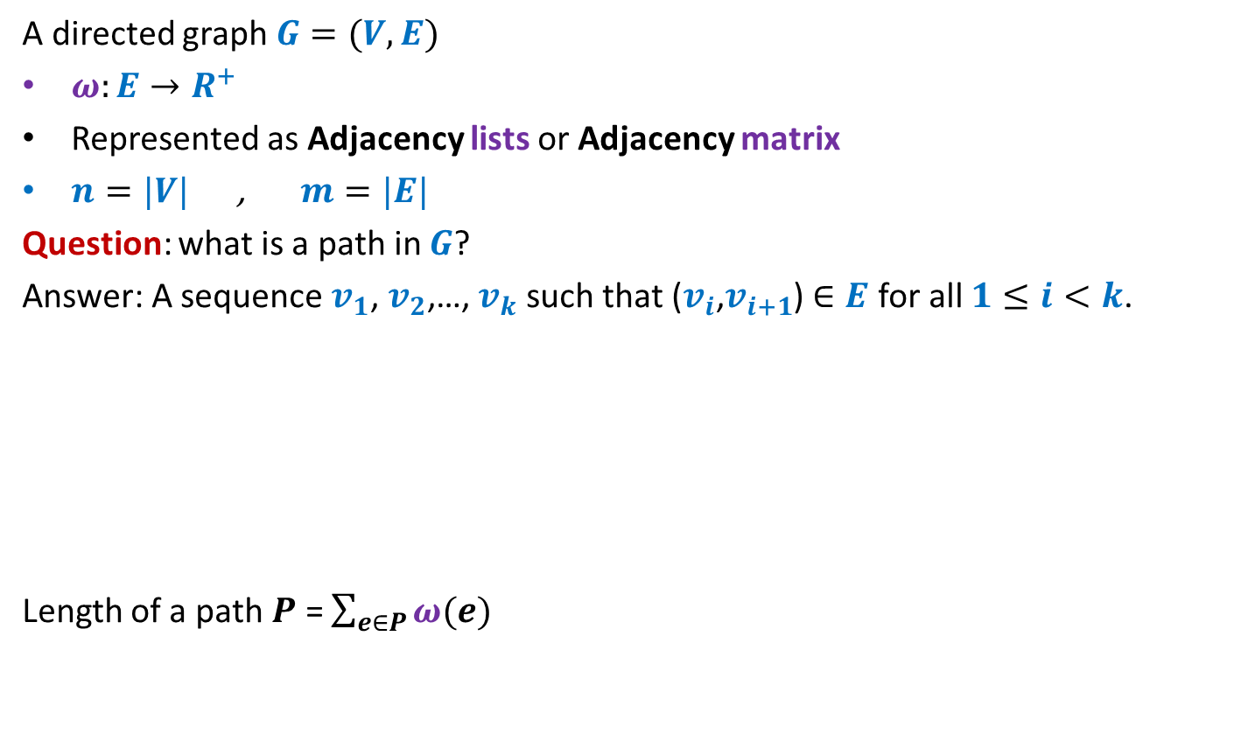



Notations and Terminologies
A directed graph $G=(V,E)$
$ω:E→R^{+}$
Represented as Adjacency lists or Adjacency matrix
$n=|V|$ , $m=|E|$
Question: what is a path in $G$?
Answer: A sequence $v_{1}$, $v_{2}$,…, $v_{k}$ such that ($v_{i}$,$v_{i+1}$) $∈E$ for all $1≤i<k$.
Length of a path $P$ = $\sum_{e∈P}{ω(e)}$
No vertex is repeated
12
3
…
29
$$v_{1}$$
$$v_{2}$$
$$v_{3}$$
$$v_{k−1}$$
$$v_{k}$$

Slide 30
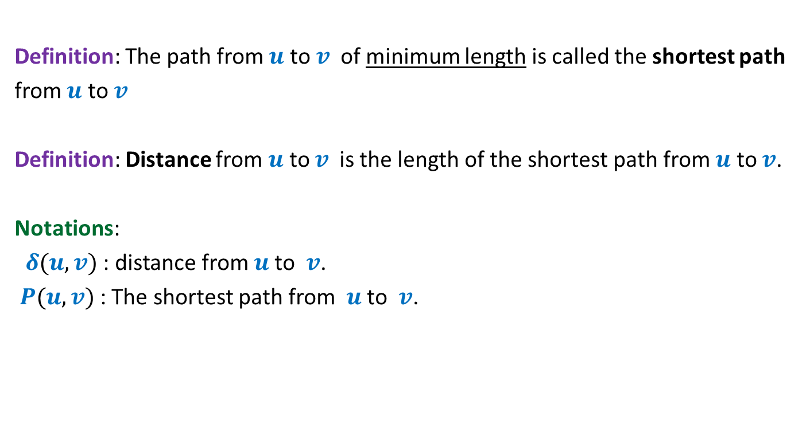
Notations and Terminologies
Definition: The path from $u$ to $v$of minimum length is called the shortest path
from $u$ to $v$
Definition: Distance from $u$ to $v$is the length of the shortest path from $u$ to $v$.
Notations:
$δ(u,v)$ : distance from $u$to $v$.
$P(u,v)$ : The shortest path from $u$to $v$.

Slide 31
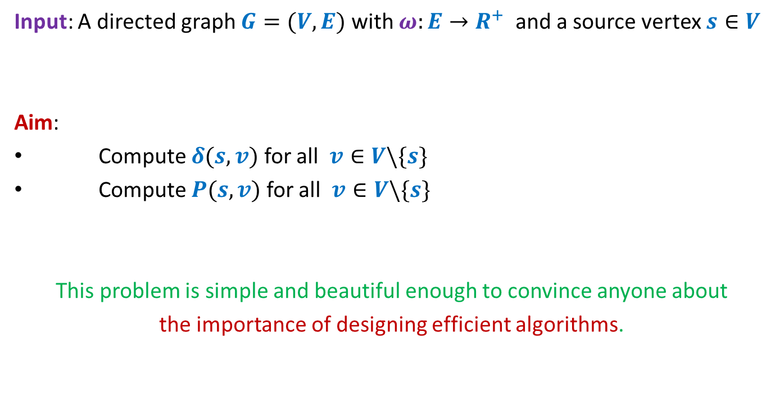
Problem Definition
Input: A directed graph $G=(V,E)$ with $ω:E→R^{+}$ and a source vertex $s∈V$
Aim:
Compute $δ(s,v)$ for all $v∈V\backslash \{s\}$
Compute $P(s,v)$ for all $v∈V\backslash \{s\}$
This problem is simple and beautiful enough to convince anyone about
the importance of designing efficient algorithms.

Slide 32


An example to get an insight into this problem
Inference:
The distance to any vertex depends upon global parameters.
$$q$$
5
7
6
12
G
$$s$$
16
4
9
11

Slide 33


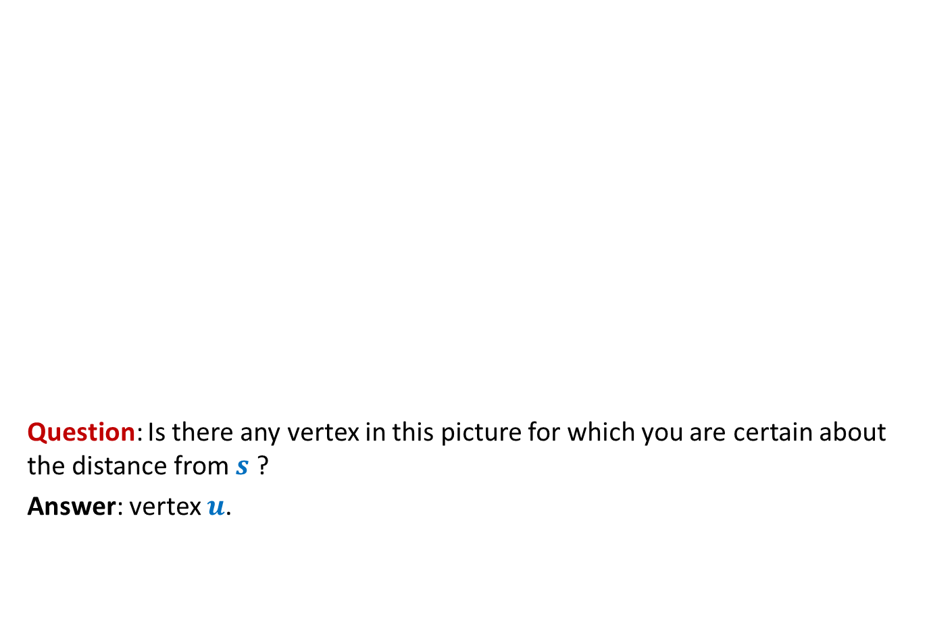



An example to get an insight into this problem
Question: Is there any vertex in this picture for which you are certain about the distance from $s$ ?
Answer: vertex $u$.
$$z$$
10
$$v$$
G
12
7
$$x$$
$$s$$
3
5
$$u$$
$$y$$
Give reasons.

Slide 34


An example to get an insight into this problem
➔ The shortest path to vertex $u$ is edge ($s$,$u$).
$$z$$
10
$$v$$
G
12
7
$$x$$
$$s$$
3
5
$$u$$
$$y$$
$$>0$$

Slide 35






Designing a greedy algorithm for shortest paths
Establish a relation between shortest paths in $G$
and
shortest paths in $G′$
$$G$$
instance of size $n$
Greedy
step
$$G′$$
instance of size $<n$
How will $G′$ look like ?
Do it as Homework

